Slide 1

Developing Machine Learning Models to Detect Arrhythmia from ECG Data - Interpretability
Shourya Verma - 2308432v

Slide 2
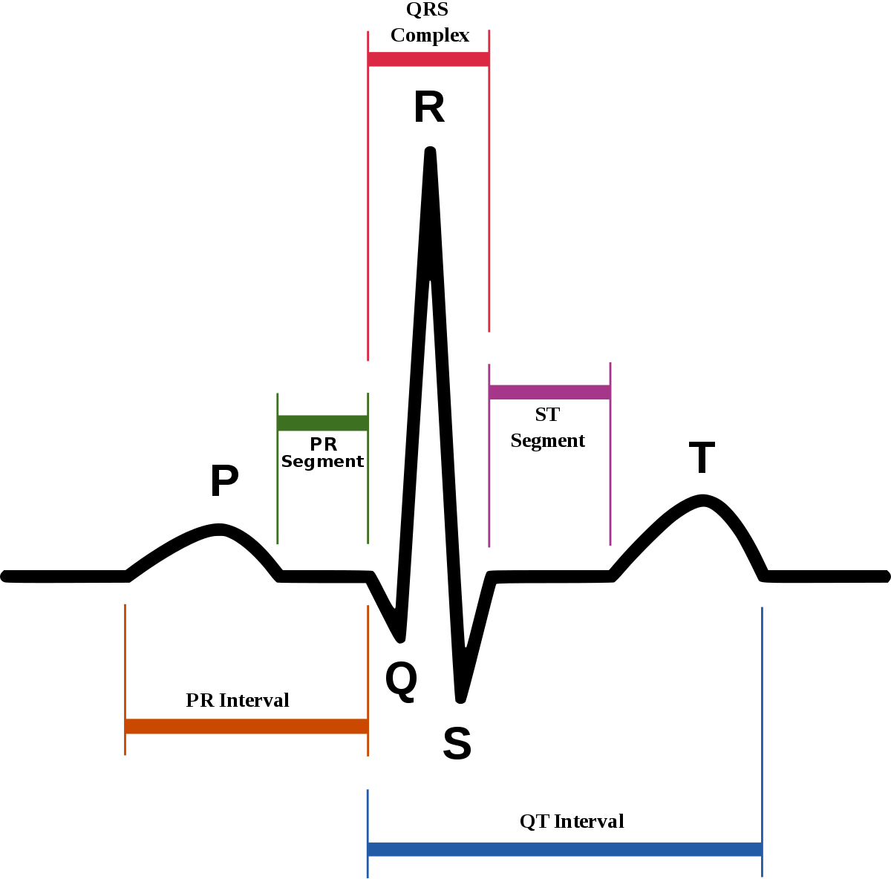
Outline
https://commons.wikimedia.org/w/index.php?title=File:SinusRhythmLabels.svg&oldid=464693489
Project Background
Machine Learning on Time-Series
Interpretability Techniques
Results
Evaluation
Conclusion
Motivation
The investigation of model interpretability is vital for healthcare industry.
The motivation of this project was to find the best performing interpretability technique for ECG Classification.

Slide 3
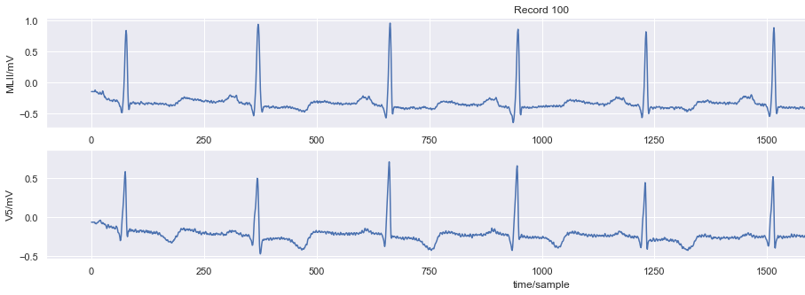
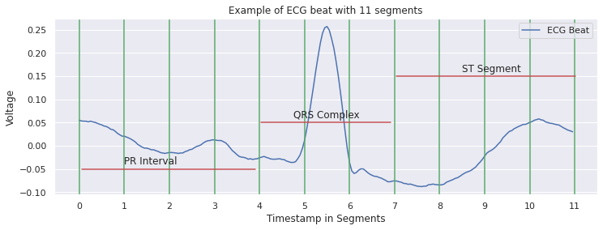
Project Background
The Electrocardiogram (ECG) is a medical test that detects cardiac abnormalities by measuring the electrical signals generated by the heart during contraction.
Machine Learning (ML) classification allows models to learn the features of a heartbeat and detect abnormalities.
The models however fail to recognize unseen ECG and face interpretability and explanation problems. These gaps occur due to the black-box nature of ML models which limit their application in patient driven healthcare industry.
This project investigates these concerns by using and building ML models for ECG classification and implementing Global and Local Interpretability techniques on some of these models.

Slide 4
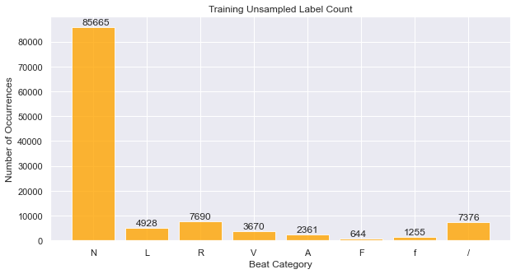
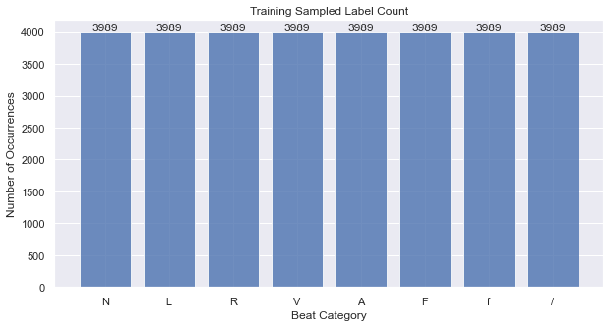
Machine Learning on Time-Series
This project implemented supervised multi-class machine learning (ML) classification where the goal is to correctly identify the class an input corresponds to.
The ML model algorithms used were naive Bayes’, ensemble methods, support vector machines, deep and recurrent neural networks.
To address the imbalance between the classes in the MIT-BIH data-set, the resampling technique called bootstrap method was used.

Slide 5
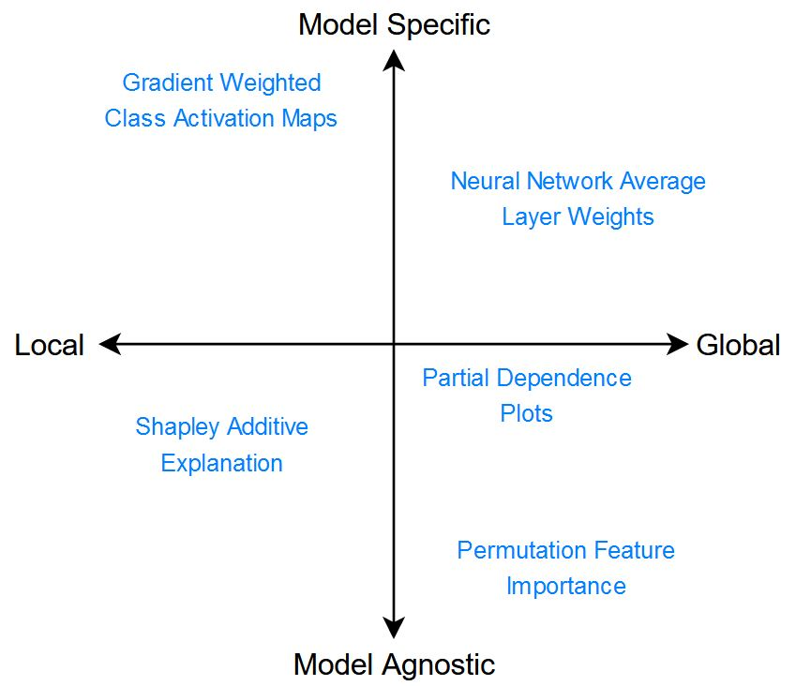
Interpretability Techniques
The degree to which humans can consistently predict the model’s prediction process.
Interpretability has four attributes namely:
Global and Local interpretability
Model-Specific and Model-Agnostic interpretability
Global interpretability methods:
Partial Dependency Plots (PDP)
Permutation Feature Importance (PFI)
Local interpretability methods:
Shapley Additive Explanations (SHAP)
Gradient Weighted Class Activation Maps (Grad-CAM)

Slide 6
Interpretability Techniques
Permutation Feature Importance (PFI) intermixed / permuted segment values to compute importance.
Model Agnostic method but only Global explanations
Gradient-Weighted Class Activation Maps (Grad-CAM) created heatmaps using gradients of final layers.
Both Global and Local explanations through averaging beats per class, but specific to neural networks
Explanation of both correct and misclassified beats
Partial Dependency Plots (PDP) calculated the marginal effects each segment had over the other.
Explanations only Global and extremely uninformative
Shapley Additive Explanations (SHAP) combined LIME and Shapley using a game theory approach.
Both Global and Local explanations
Explained limited instances and extremely slow

Slide 7
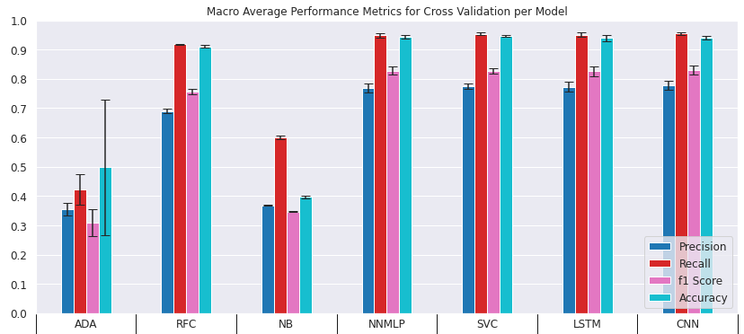
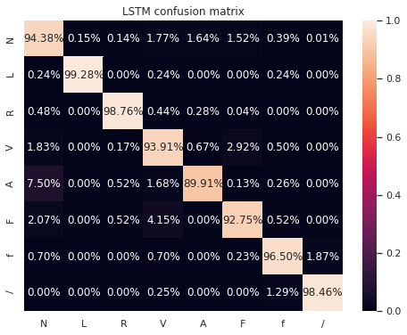
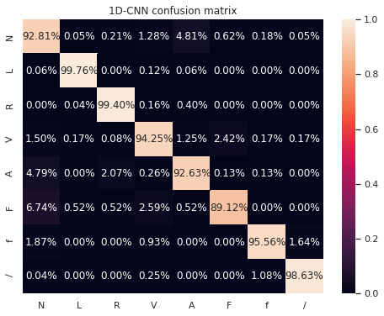
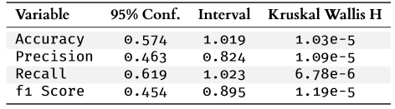
Classifier Results Stratified K-Fold Cross Validation Beats Holdout 75/25

Slide 8
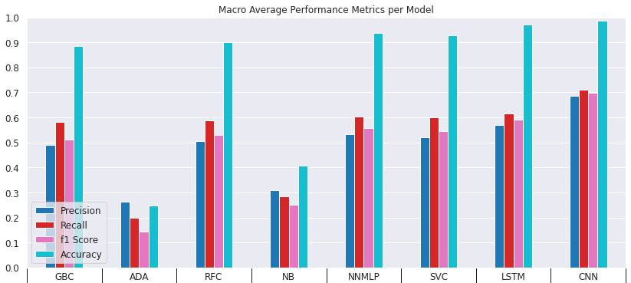
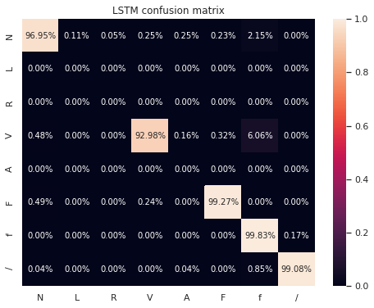
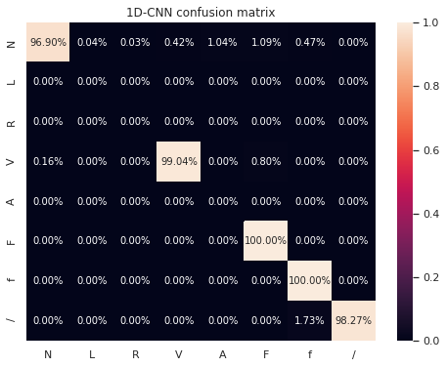
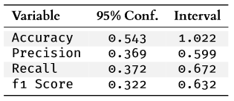
Classifier Results Leave Groups Out Patient Holdout 90/10

Slide 9
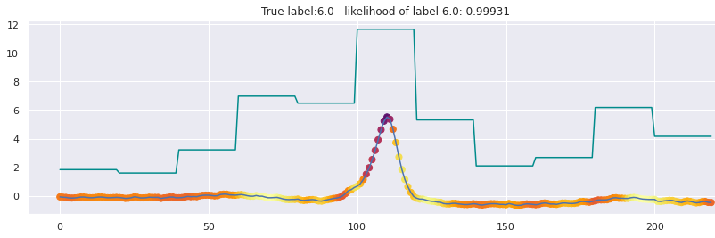
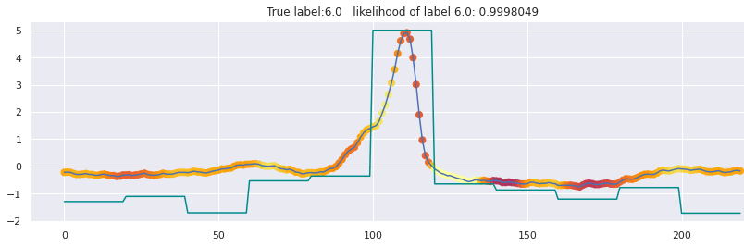
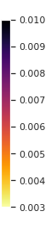
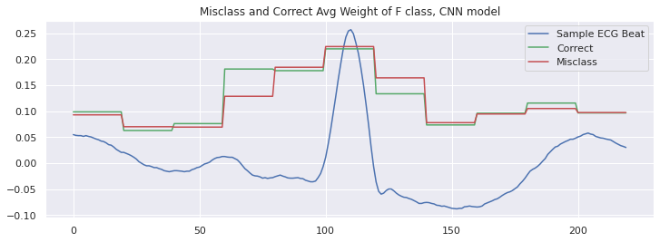
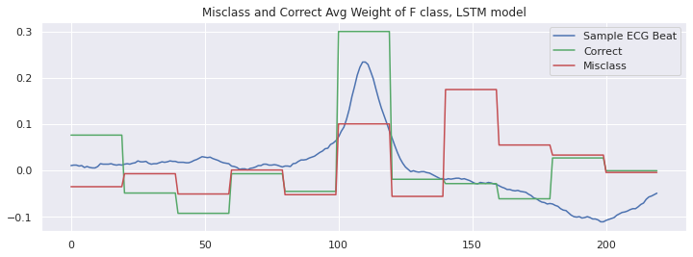
Interpretability Results
Grad-CAM CNN
Single Beat
Grad-CAM LSTM
Single Beat
Scaled Score
Average over class
Average over class
Scaled Score

Slide 10
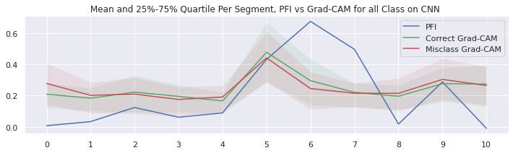
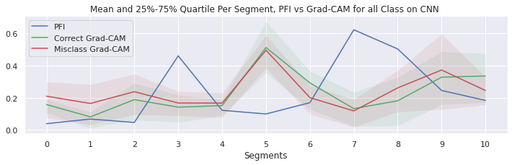
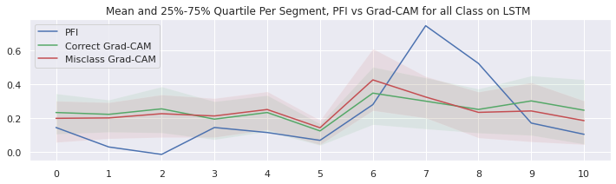
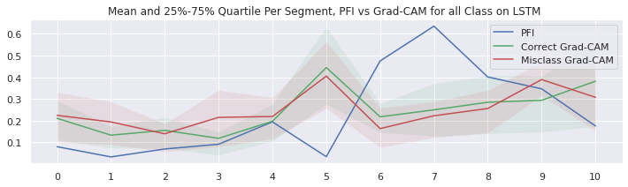
Evaluation
Quantitative Comparison Between Feature Importance and Grad-CAM per Segment.
Beat Holdout Method
Patient Holdout Method
Scaled Score
Scaled Score
Segments
Segments

Slide 11
Conclusion
CNN and LSTM classifiers were the best performing models.
Both models gave statistically significant results.
Grad-CAM was the most effective method through local explanations.
PFI was the only model agnostic technique for global explanations.
Quantitatively comparing PFI and grad-CAM values allowed for deeper analysis of the difference between local and global explanations.
Model interpretability showed that the prediction process agrees with medical literature i.e., how clinicians and cardiologists classify abnormal ECG beats.

Slide 12
Limitations
Data imbalance in MIT-BIH dataset.
Not a diverse set of patients.
Interpretability libraries struggle with time-series data.
Grad-CAM struggles to localize multiple occurrences of the same features and gives no explanation of interaction between features and inputs.
Future Work
Testing on larger and more diverse arrhythmia datasets.
Integrated Gradients as grad-CAM alternative.
Attention mechanisms to recognize critically significant ECG segments could lead to better interpretability.

Slide 13
Thank You

